Slide 1






Home Loan Management
Cover design
These slide designs and messages are inspirational only. Please modify text boxes and positioning as needed based on the message and overall composition. Always consider the legibility and contrast of copy and content for maximum usability.
Any and all photography in these designs is given as an example. While you can use them, it’s better to change the photography to match your content.
To do so, right click on the picture or placeholder to change/insert a photo.
Where to find photography:
Photo library
Getty images (Recommended), Shutterstock, Adobe images (check with your M&C design team):
Further cover examples and inspiration are available in Extras file in your Powerpoint -> File -> New from template…
Empowering Dreams with Smart Home Loans
By,
Sunia Sultana,
Gandi Tanuja,
Nagella Kushmitha,
Gade Vidyasri.
Security classification
Always add the appropriate security classification to the cover page and and footers (see classification definitions here).
Public information
Company confidential
Company restricted
Company sensitive

Slide 2

Project Overview
The Home Loan Web Application is a responsive ASP.NET Core MVC-based system designed to simplify home loan management.
It allows users to register, log in, apply for loans, calculate EMI, track loan status, and more.
The project enhances financial transparency and user experience through an integrated chatbot and responsive UI.

Slide 3

Technologies Used
ASP.NET Core MVC 8.0
Entity Framework Core
SQL Server
HTML, CSS, Bootsrap5
JavaScript, jQuery
Visual Studio 2022

Slide 4

Key Features
Apply for Home Loan
EMI Calculator
Loan Tracker
FAQ Section
Contact Us Page
About Us Page with Team Info
Chatbot(EasyHome Assistant)

Slide 5
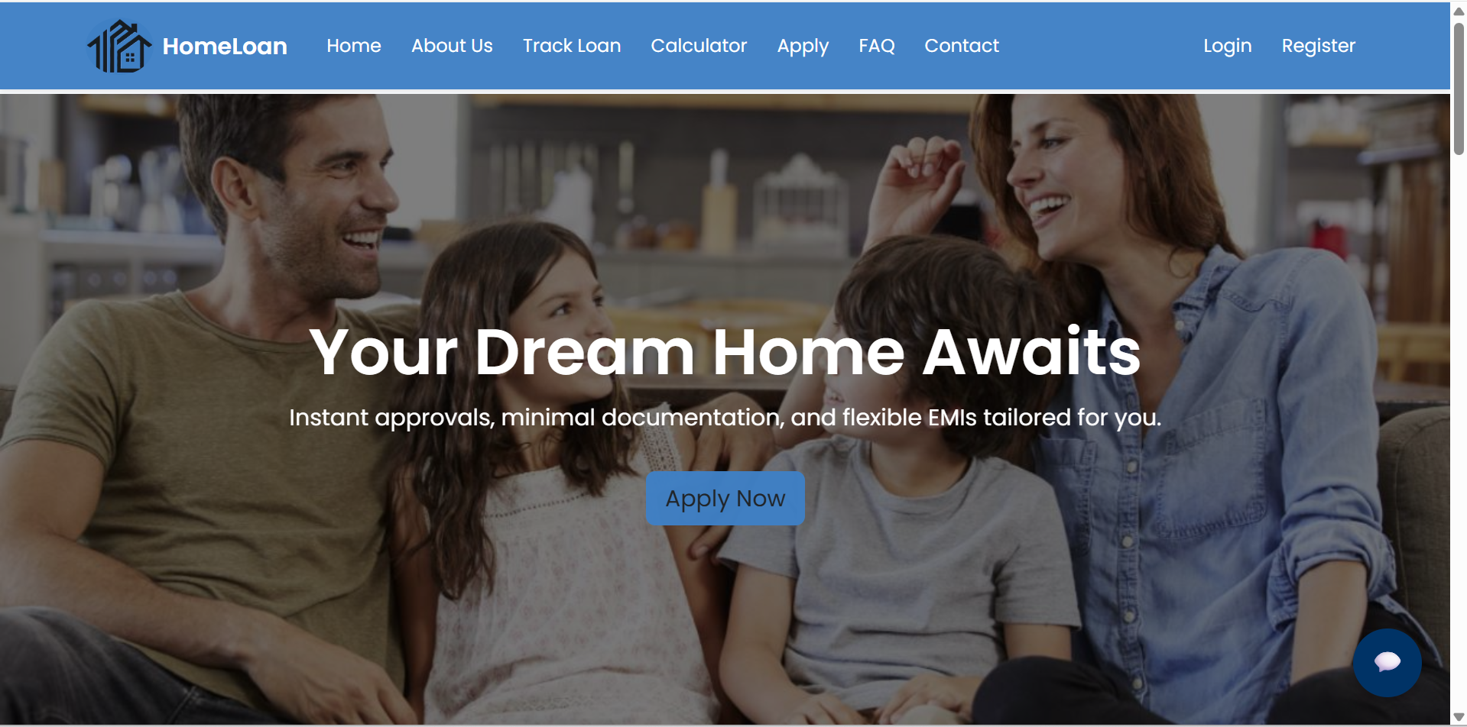
Home Page

Slide 6

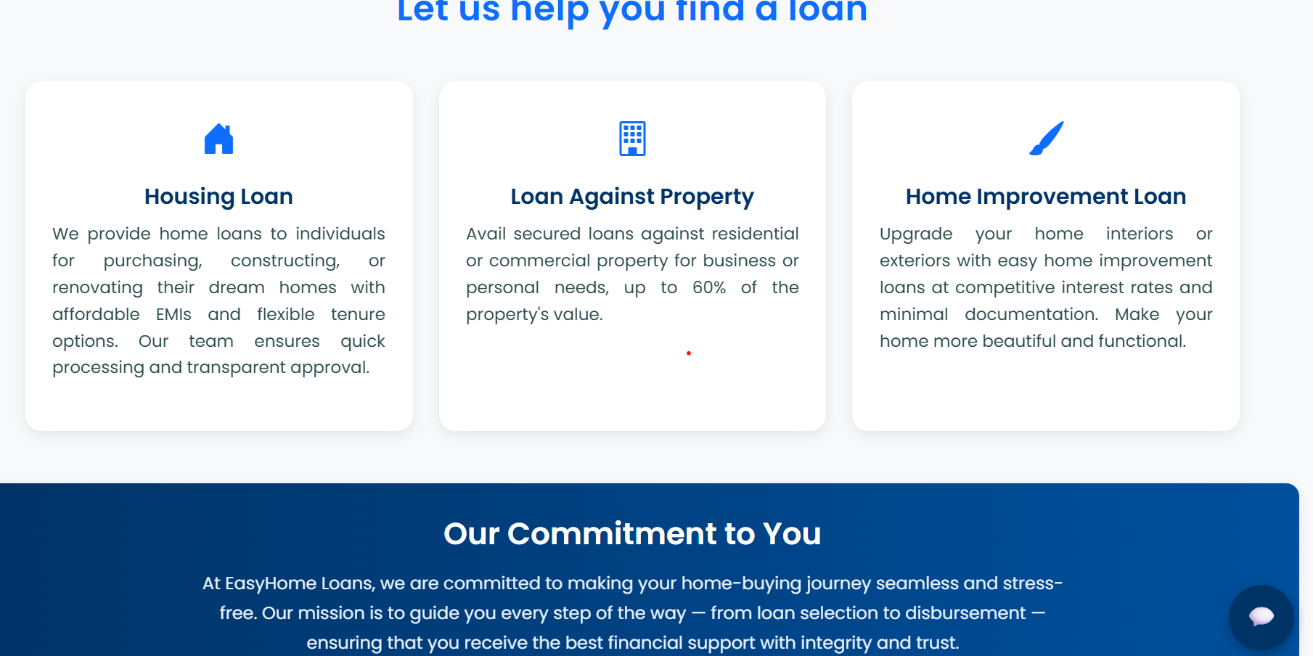
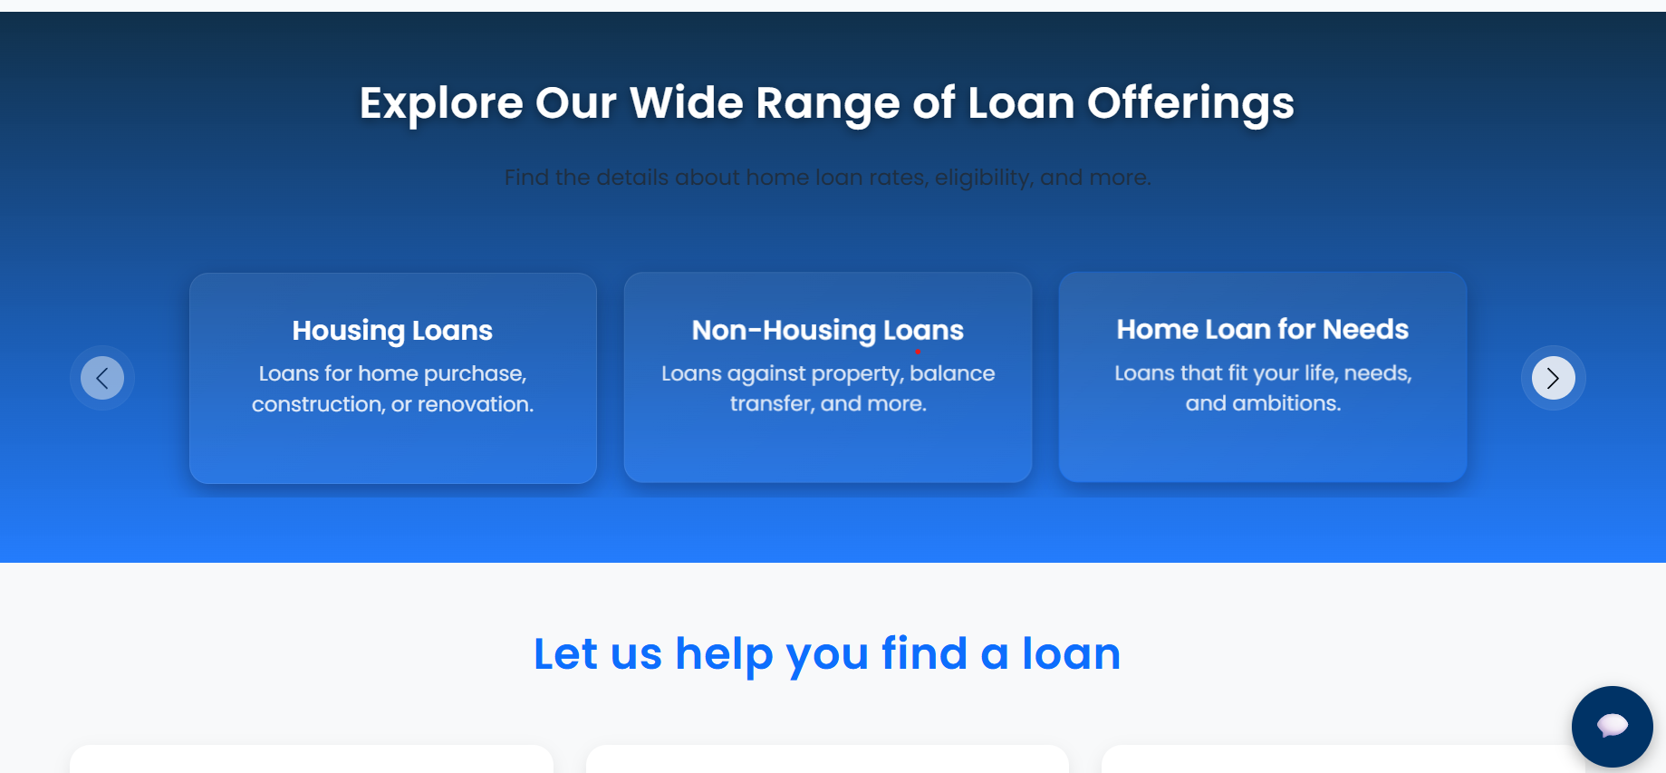
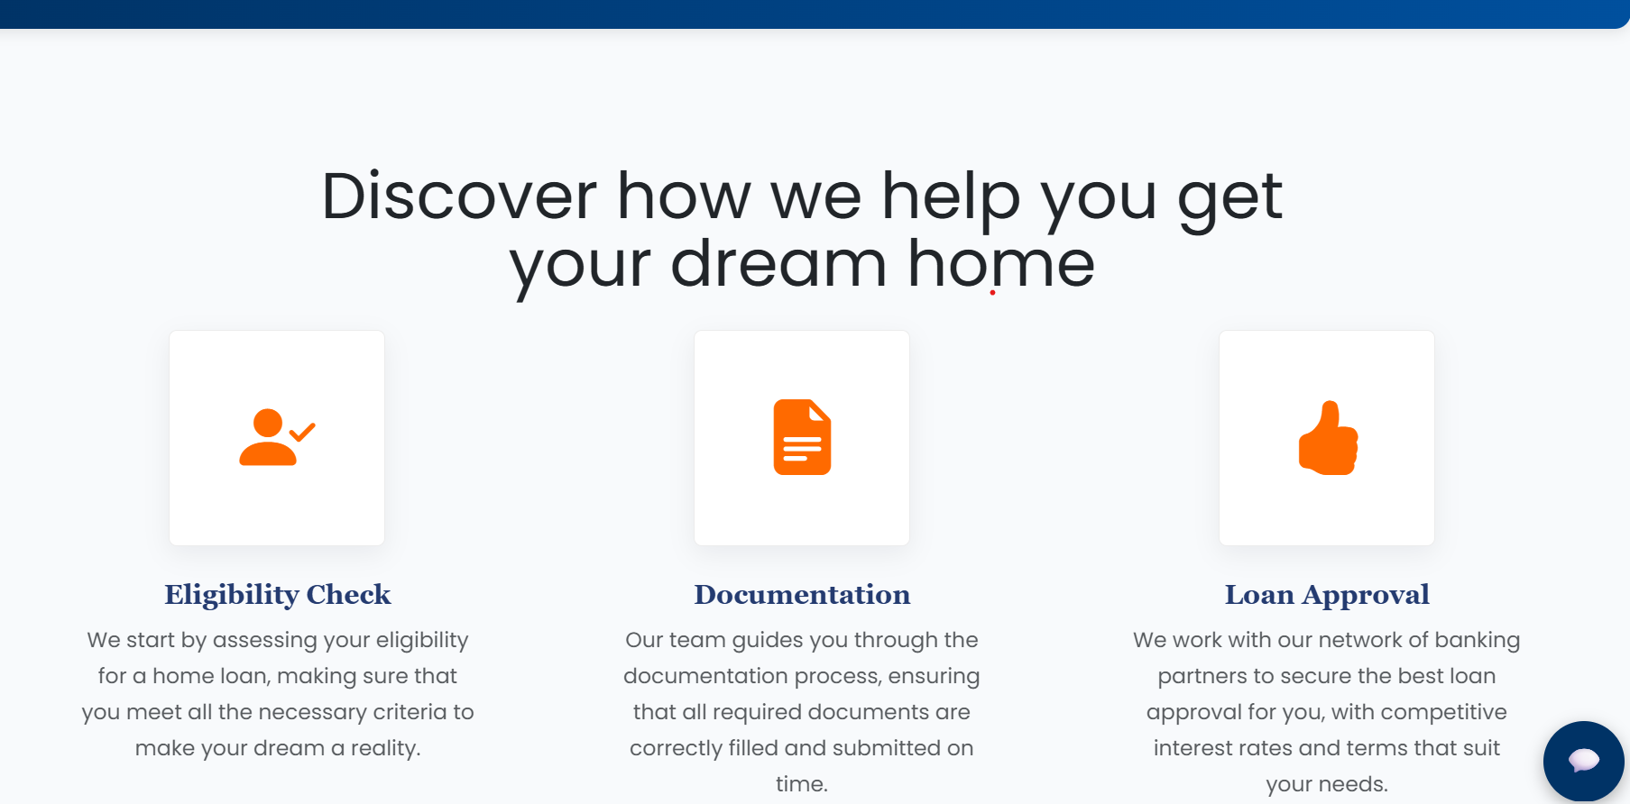
Home Page (Continuation)

Slide 7

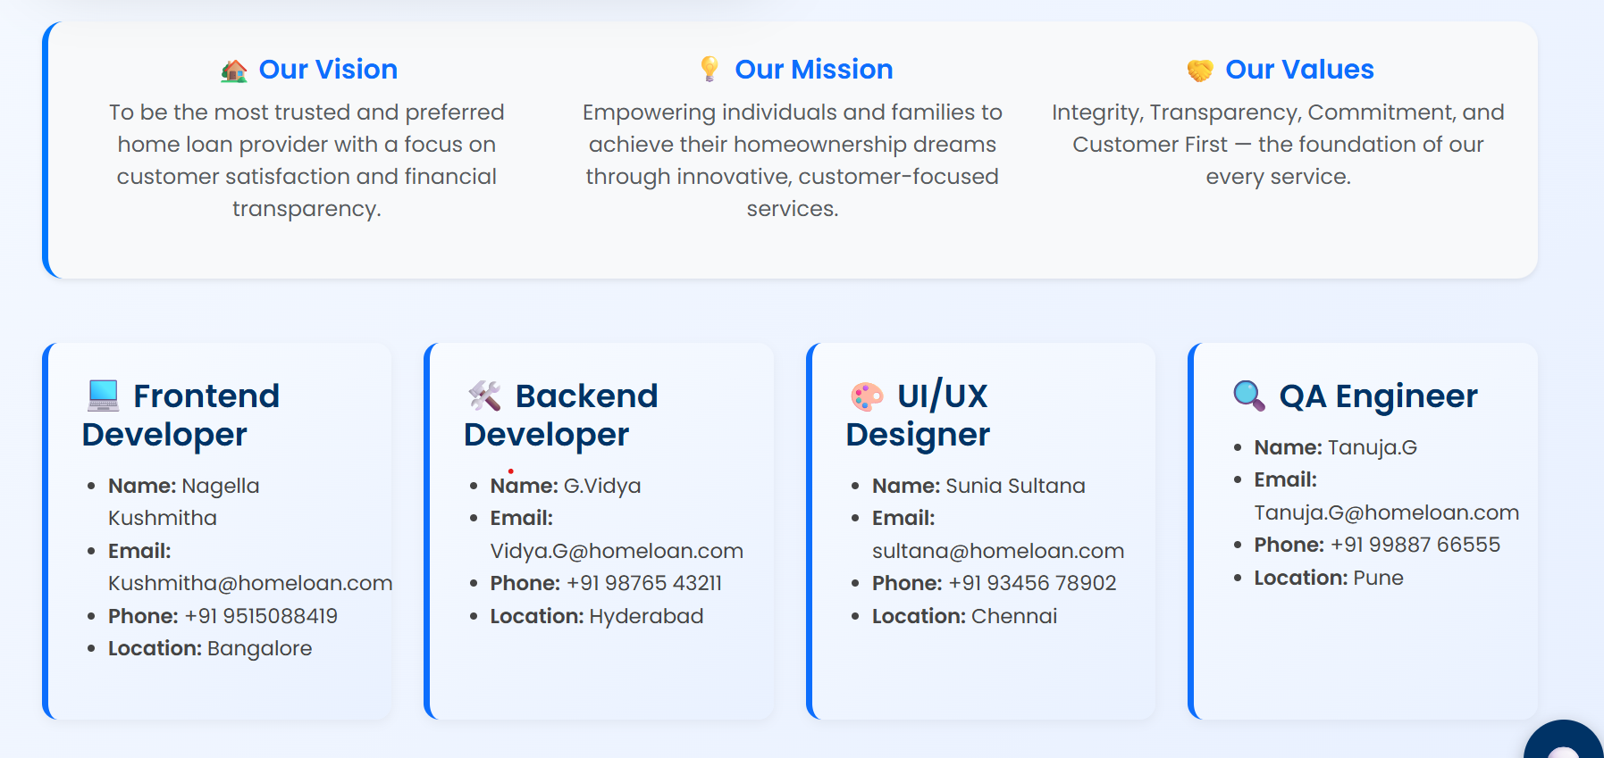
About Us Page

Slide 8
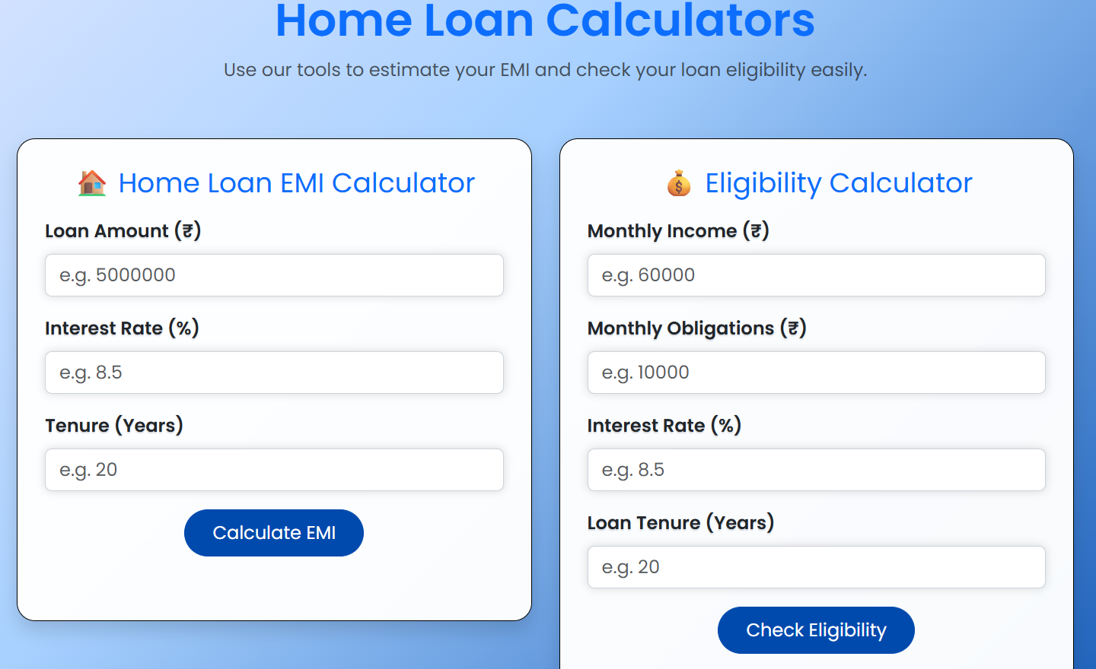
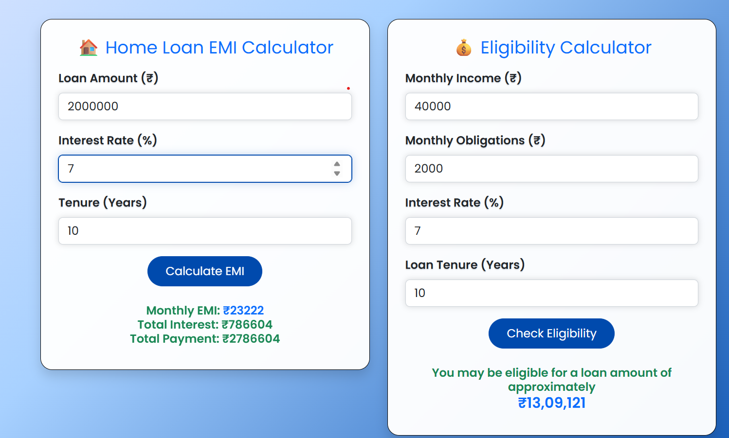
Calculator Page

Slide 9
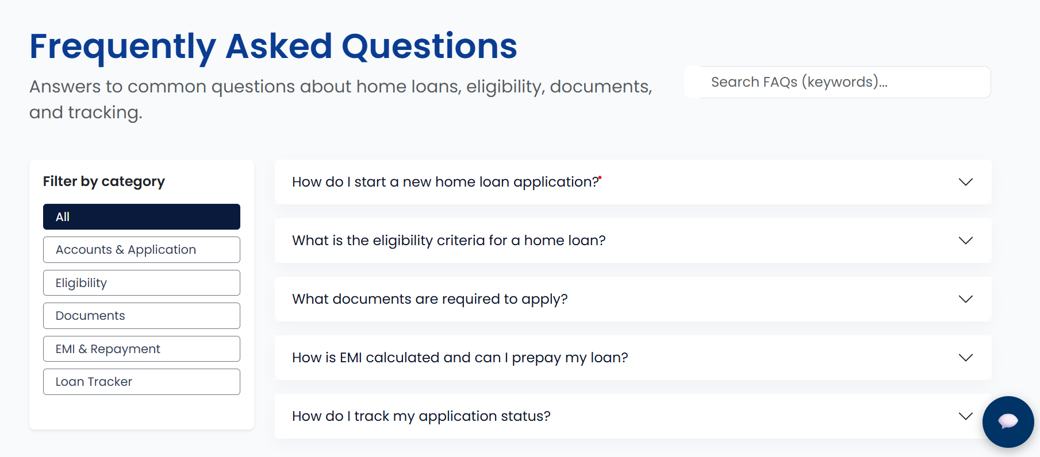
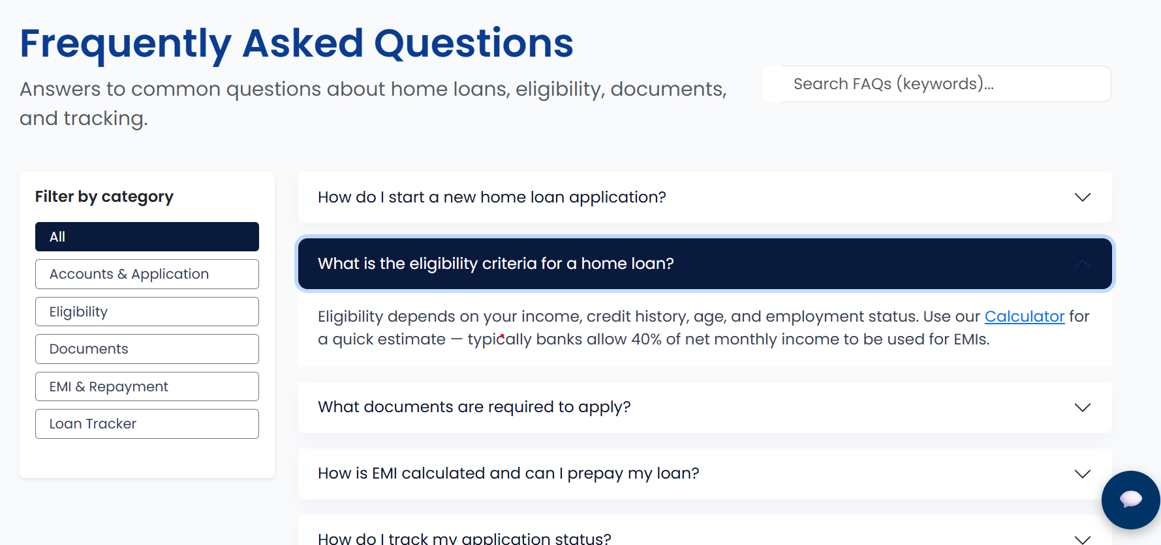
FAQ Page

Slide 10
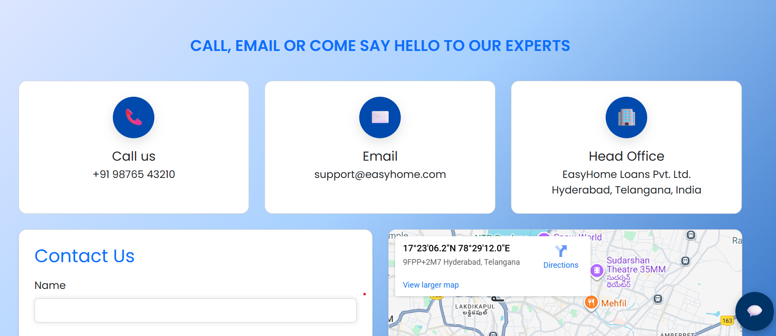
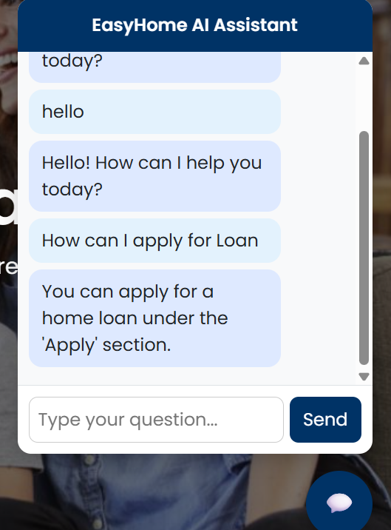
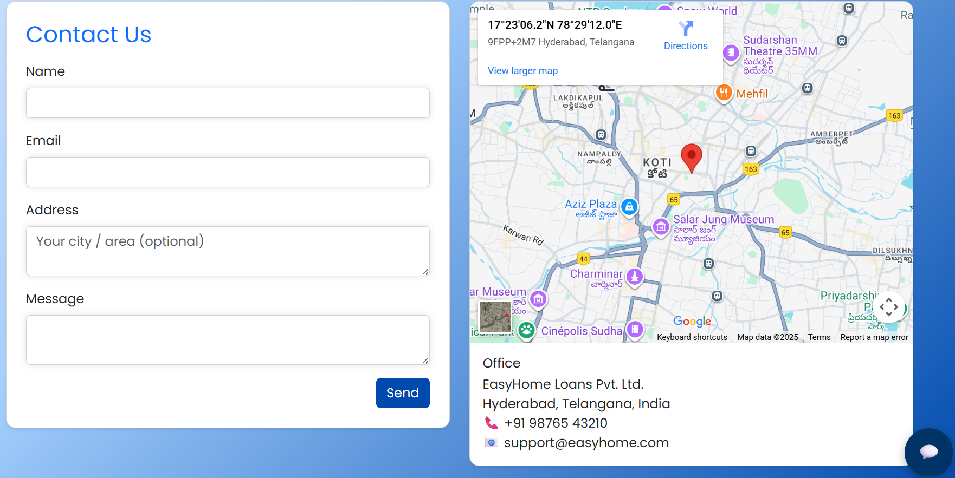
Contact Us Page

Slide 11
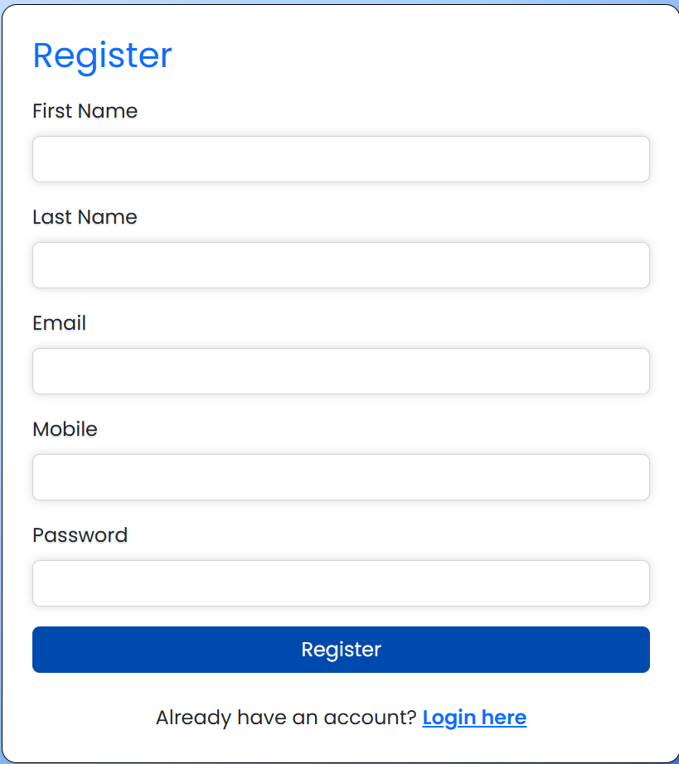
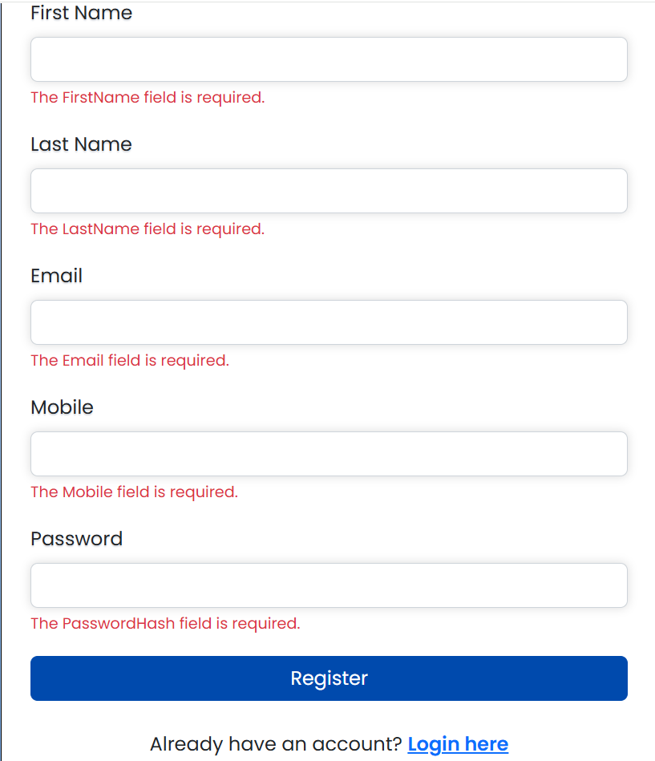
Registration Page
Registration Page(Fresh)
Registration Page(Clicked without input)

Slide 12
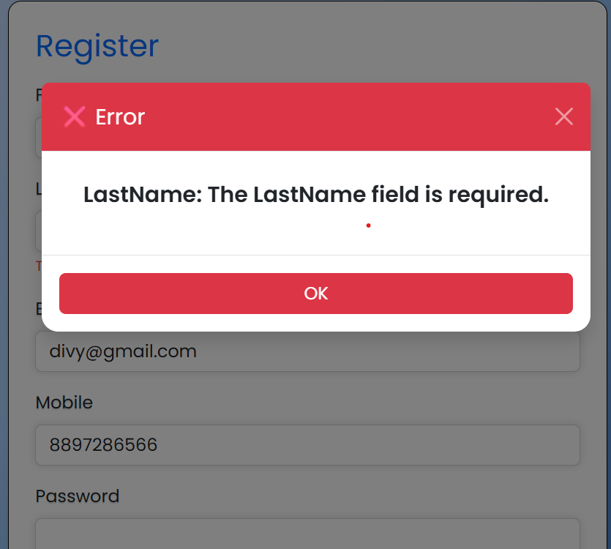
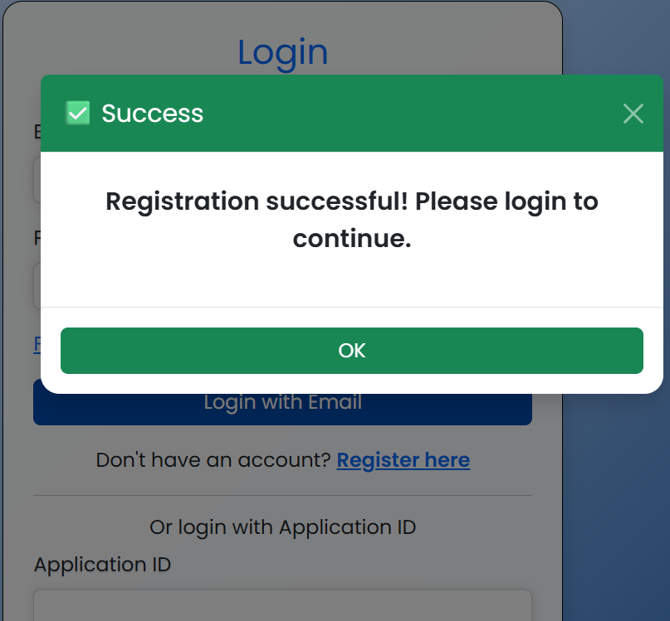
Registration update
If any Field is unentered
After creation of User Account

Slide 13
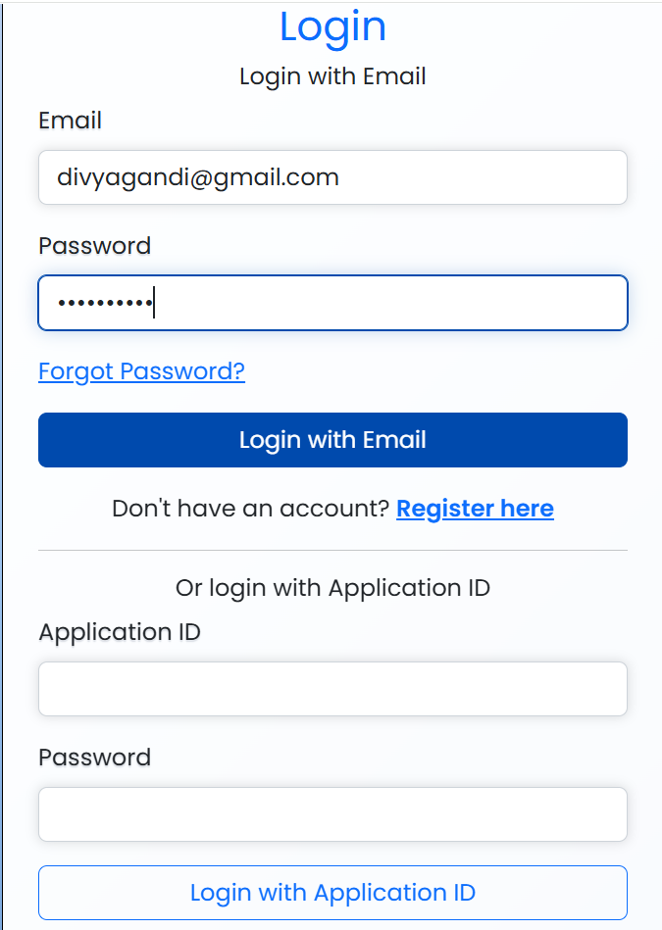
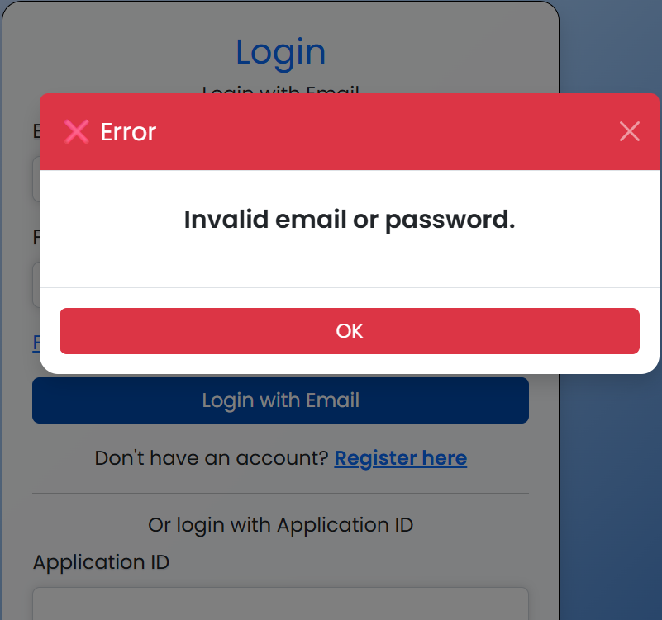
Login Page
Login Page:
If credentials are wrong:

Slide 14
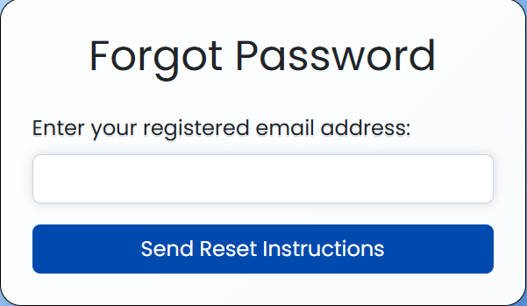
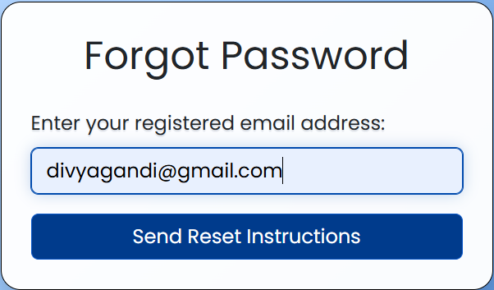
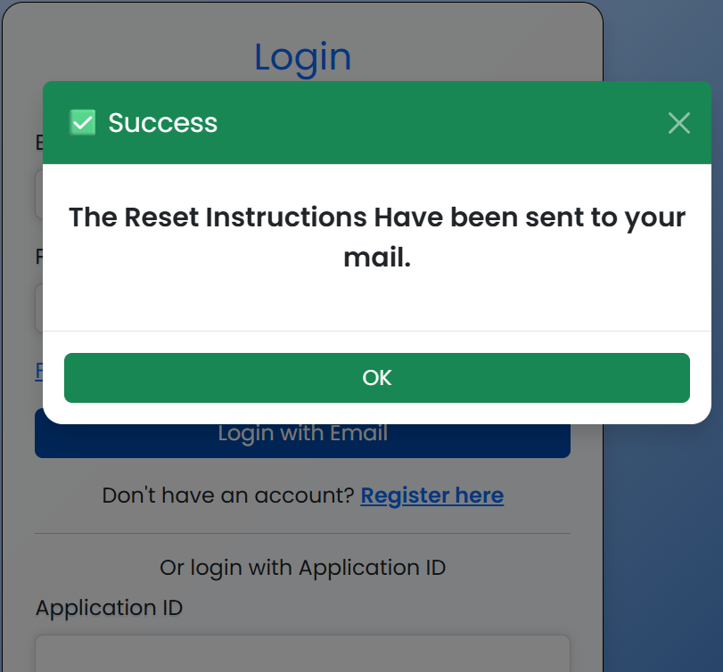
Password Reset:
Enter the email address:
Click on send:
Get the email reset Instructions

Slide 15
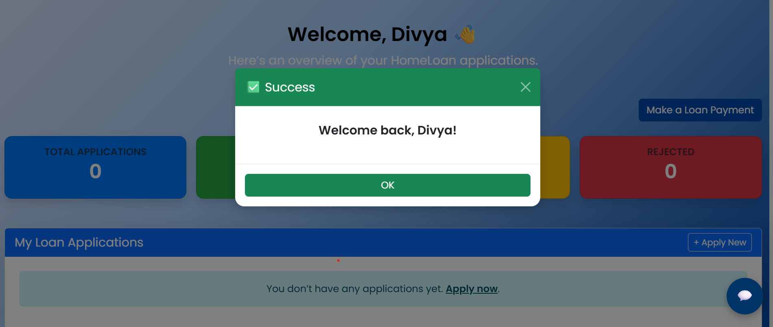
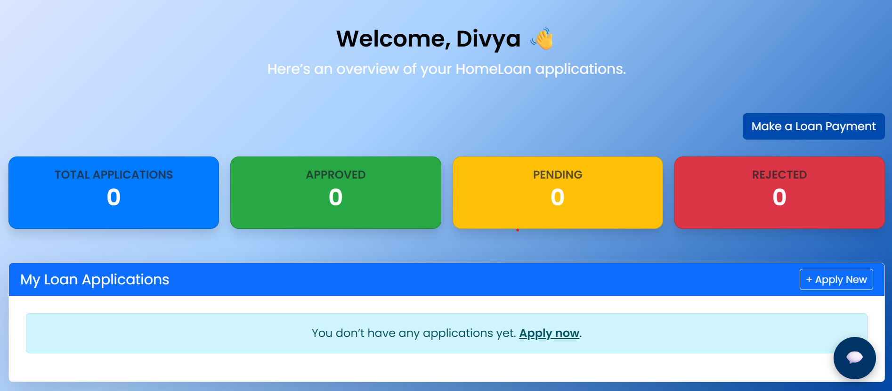
User Dashboard

Slide 16
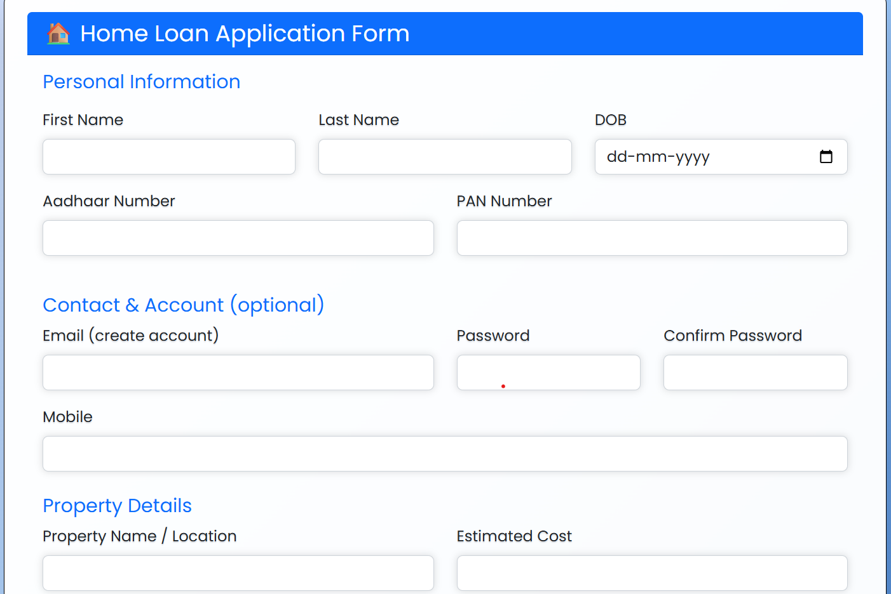
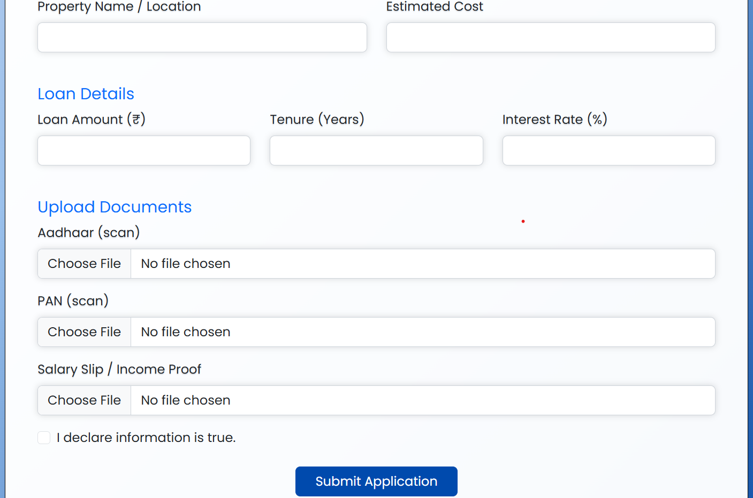
HomeLoan Application Form

Slide 17
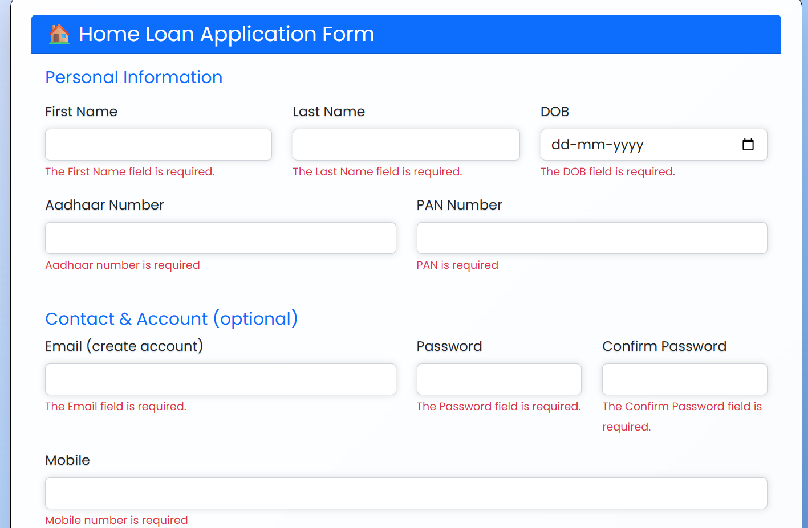
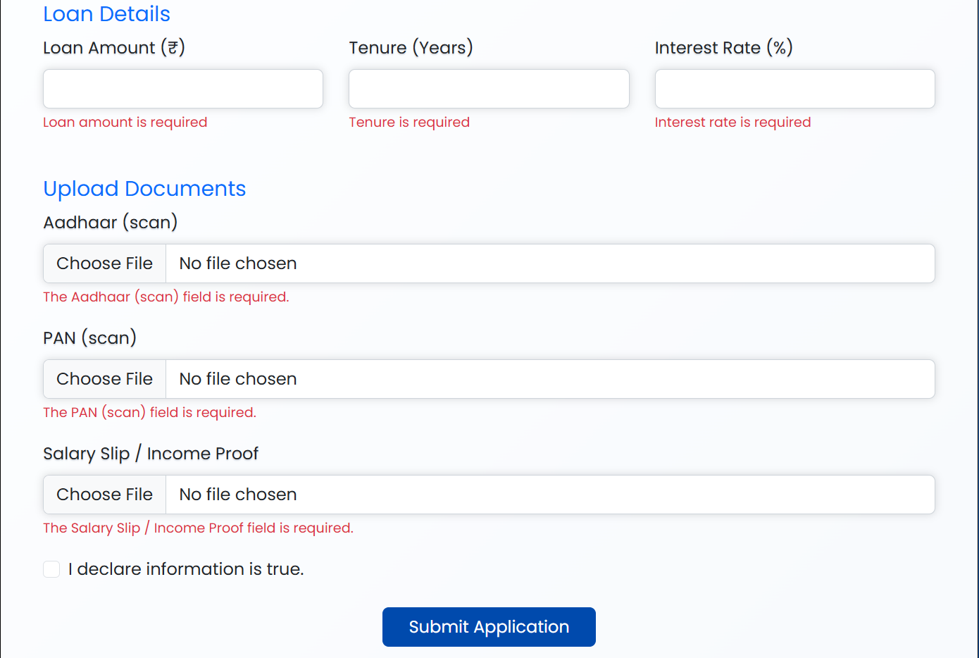
HomeLoan Application Form
Clicked submit without entering details(Validation):

Slide 18
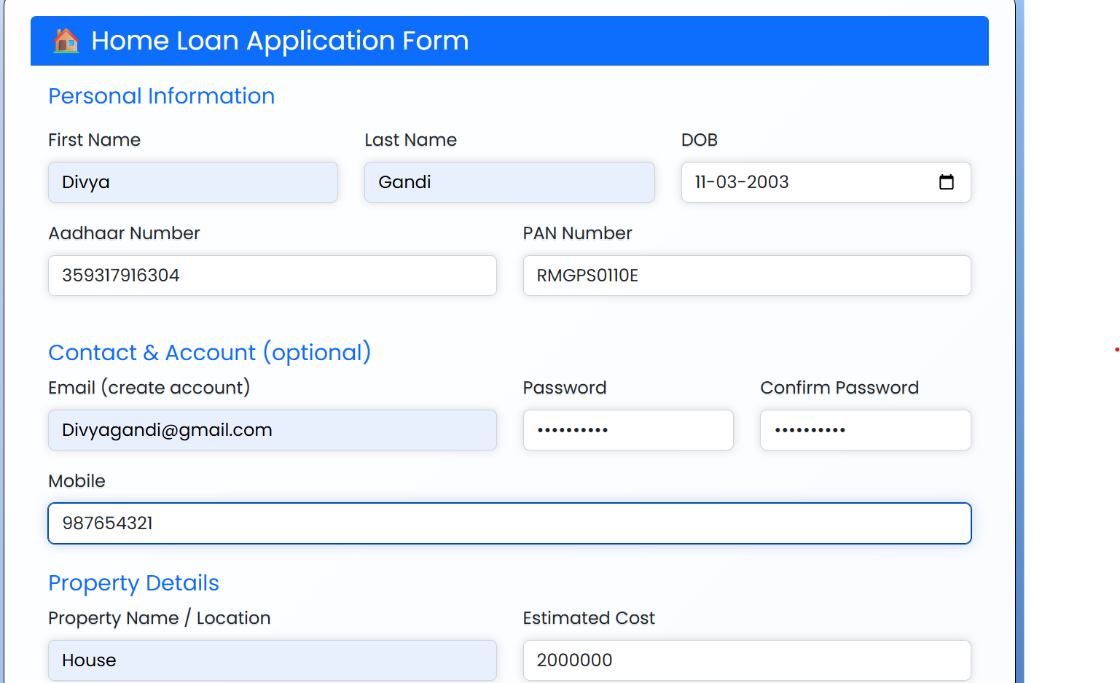
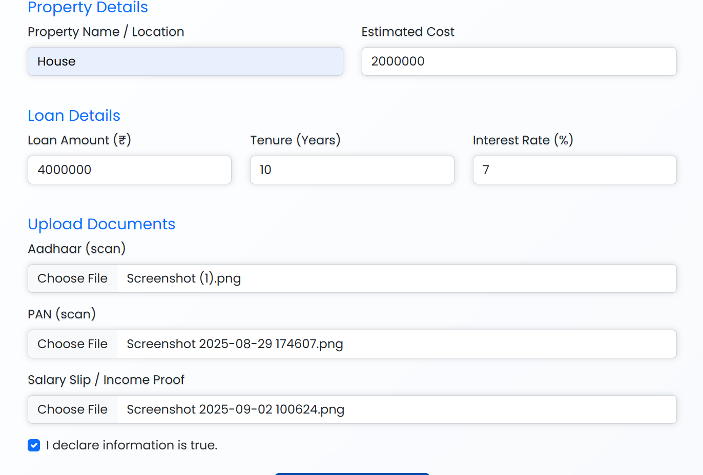
Application Form(Details Entered)
Make sure you declare your details:

Slide 19
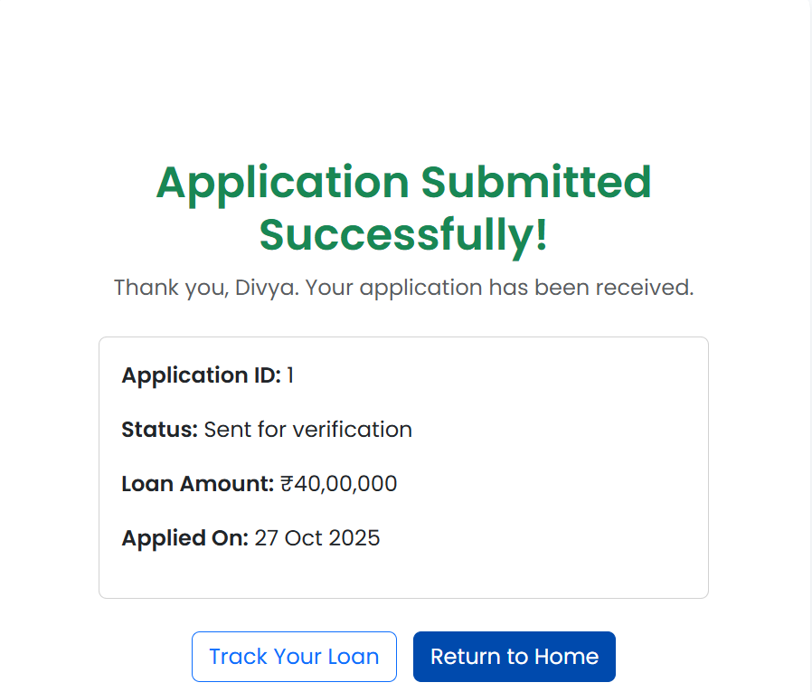
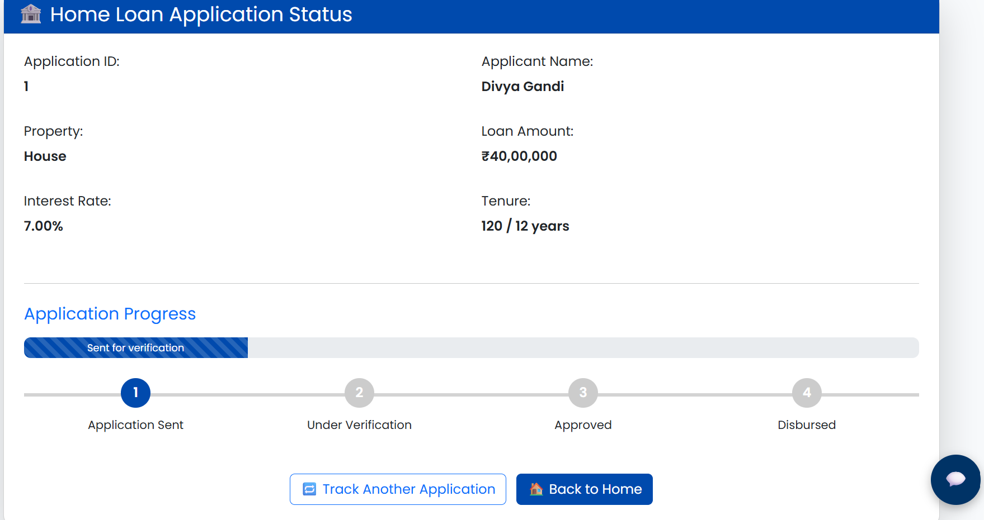
Loan Application Submission:
Application Submitted:
Loan Tracking:

Slide 20
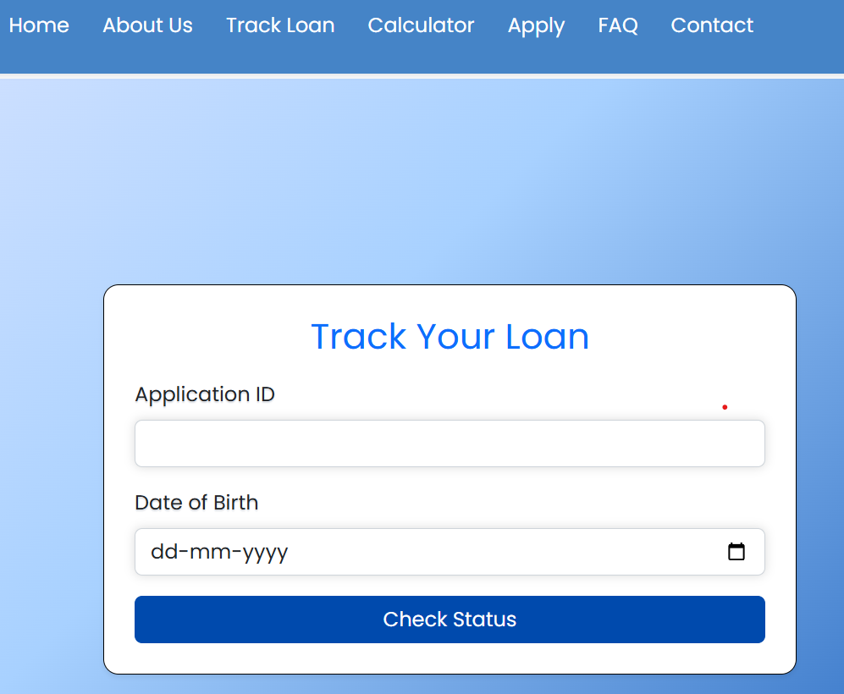
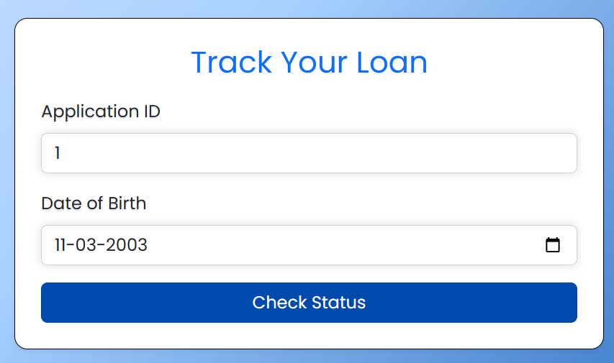
Track Loan Page

Slide 21
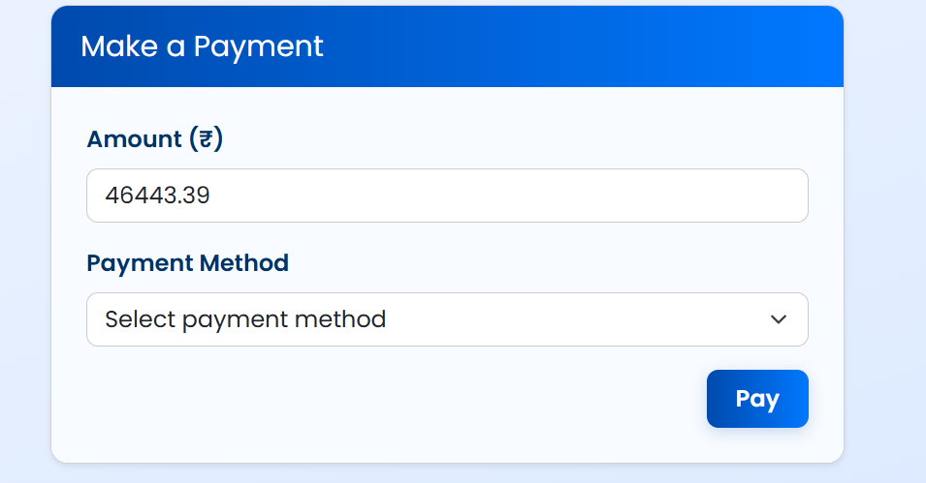
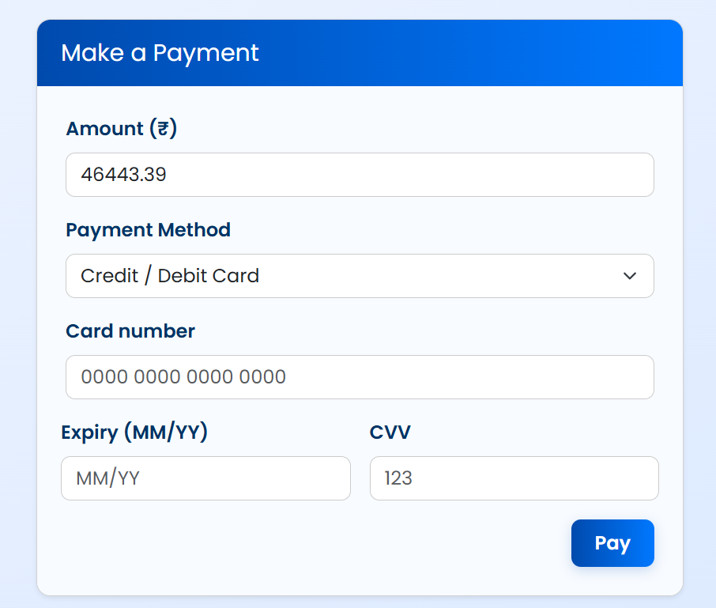
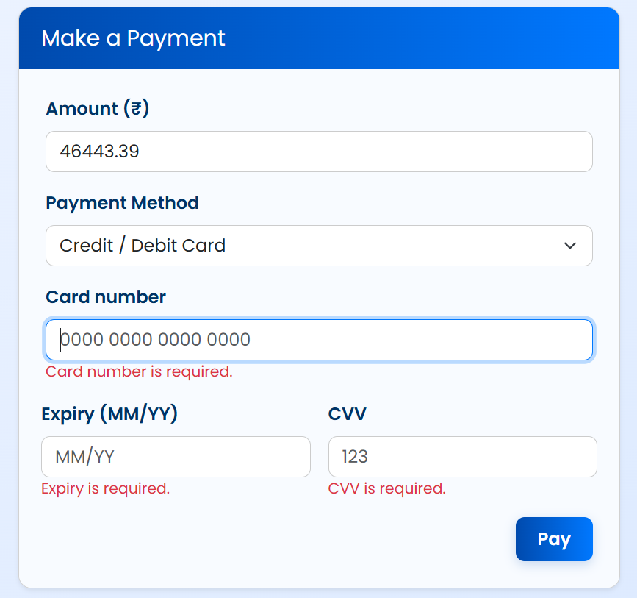
Loan Payment

Slide 22
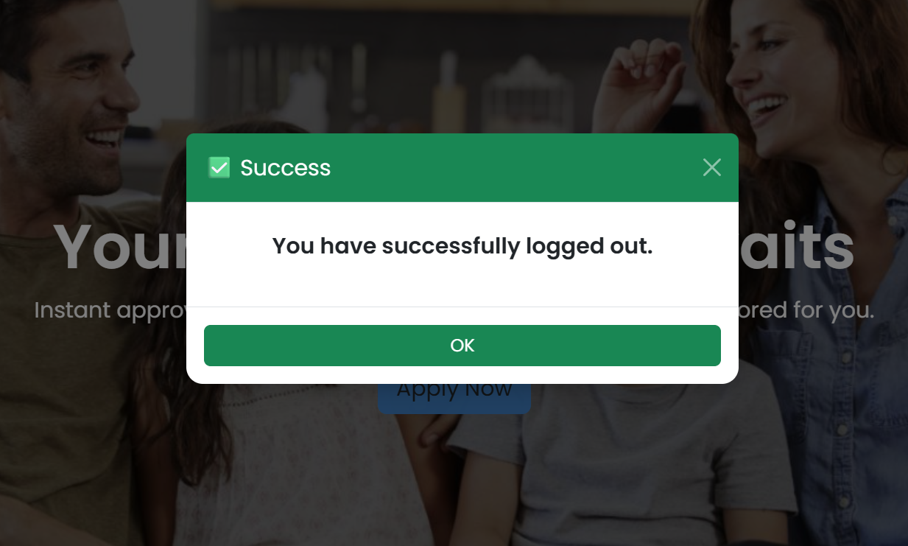
User Log Out :

Slide 23
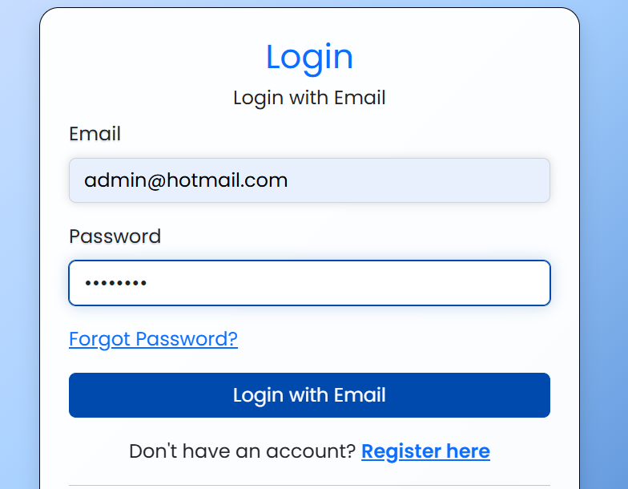
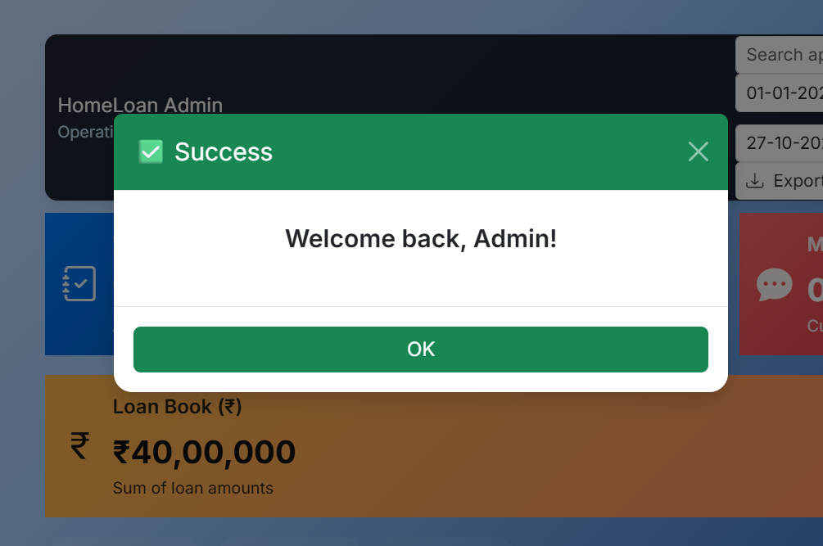
Admin Login
Admin Login Page
After Successful Admin Login

Slide 24
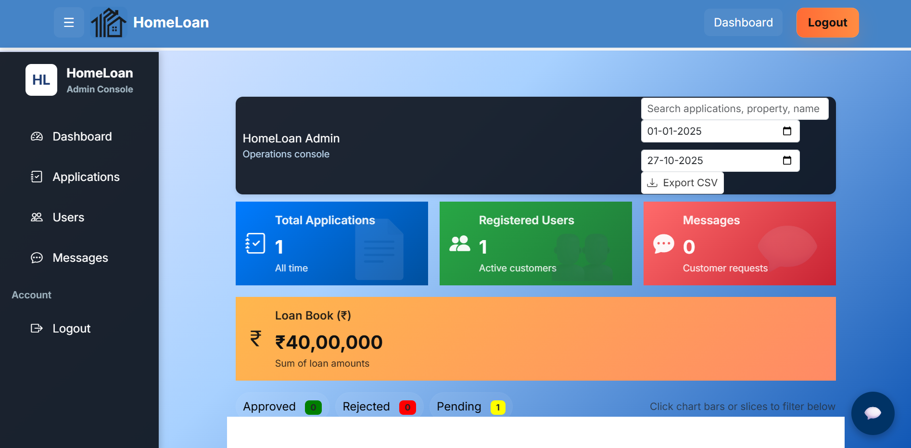
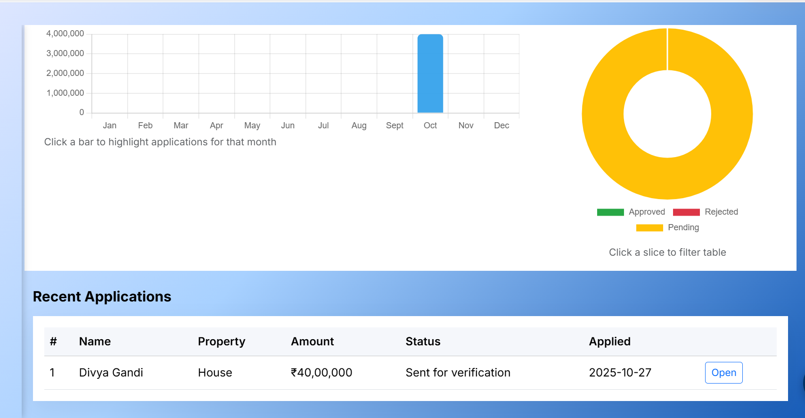
Admin Dashboard

Slide 25
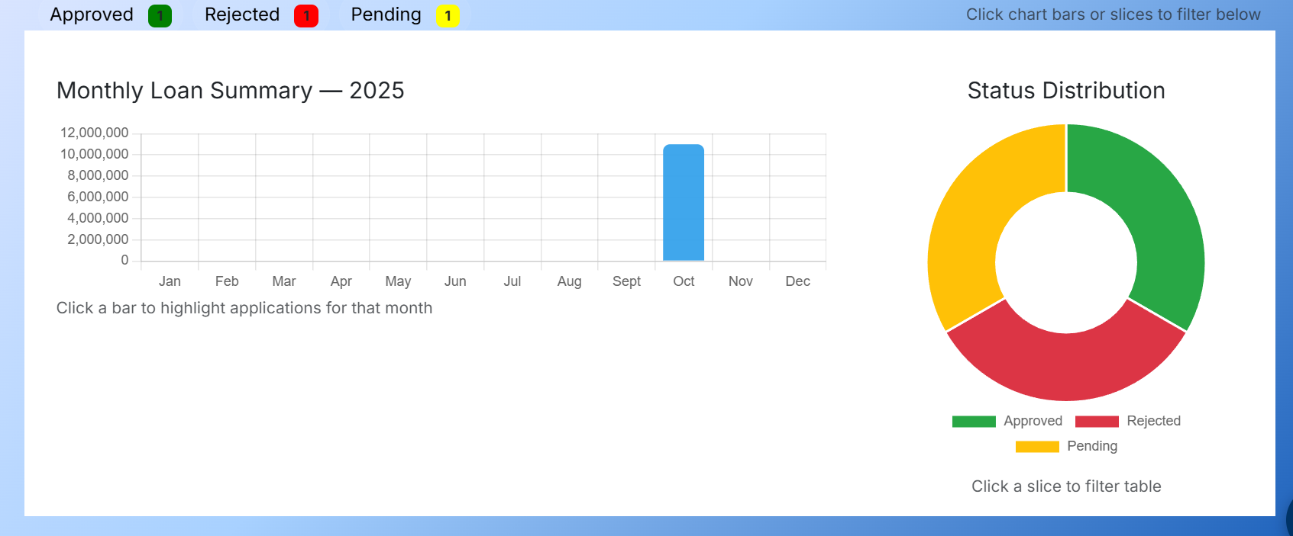
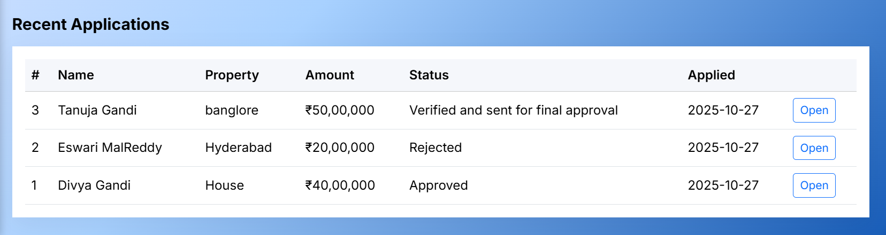
Admin Dashboard(Status Bar)

Slide 26
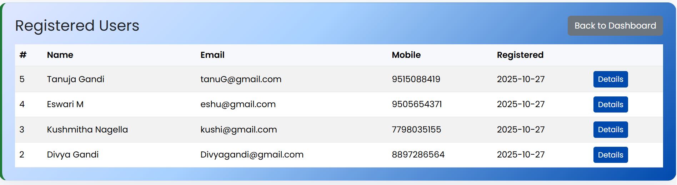
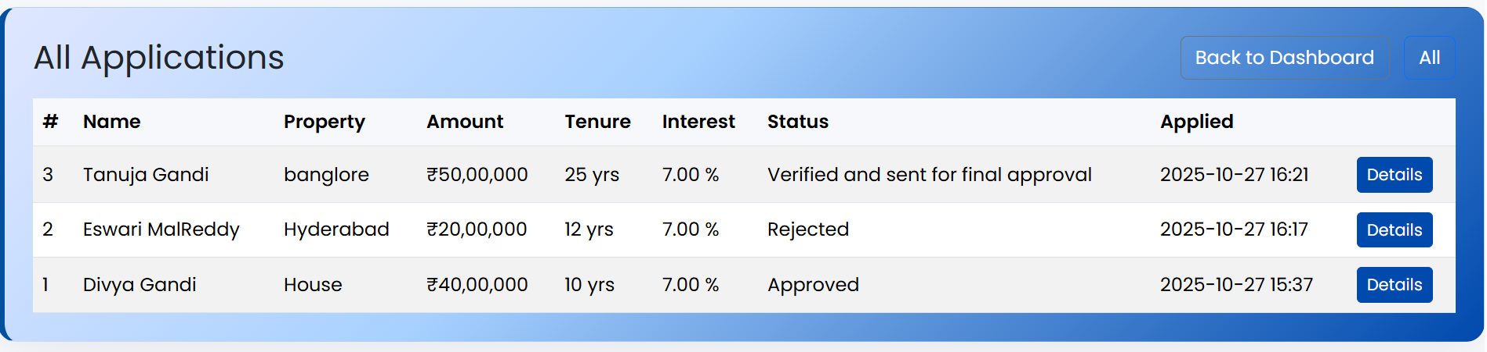
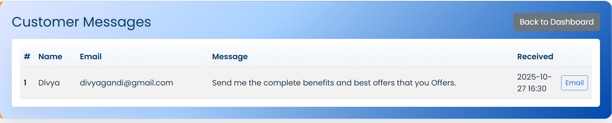
Registered User, Applications & Customer Messages:

Slide 27
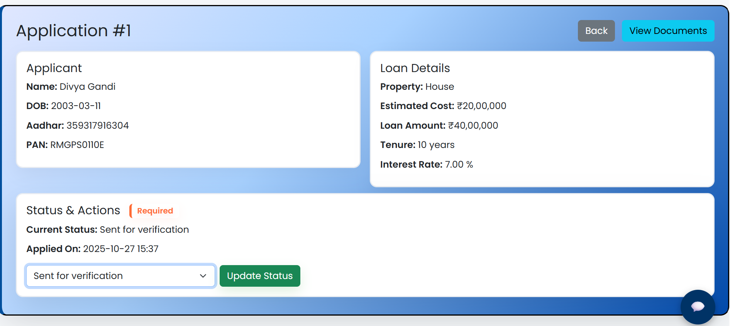
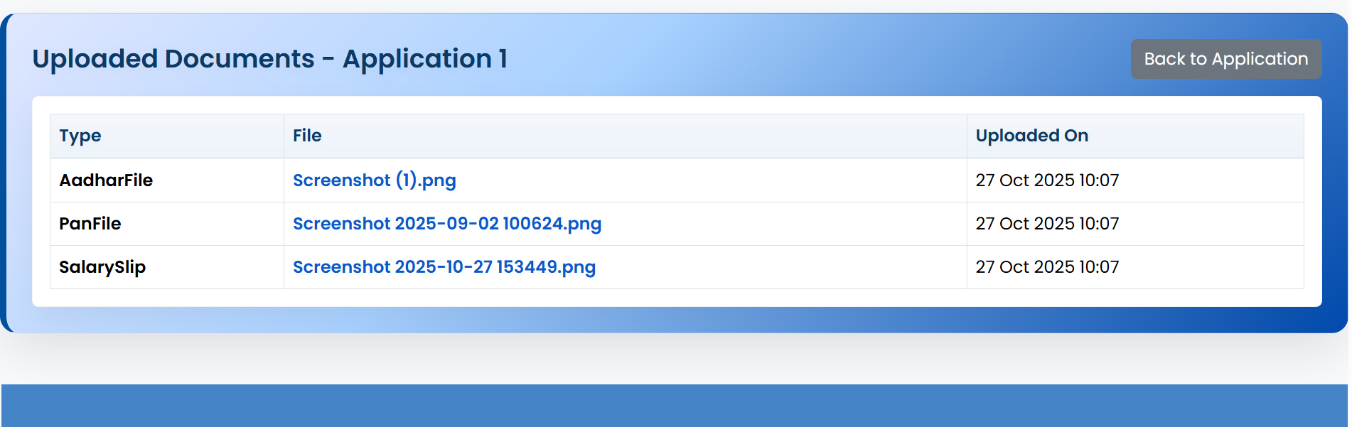
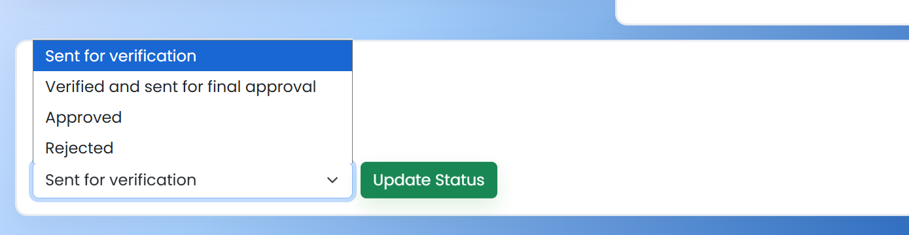
User Application Details(In Admin Portal):
Verify Application:
Verify the documents:
Update Application Status:

Slide 28
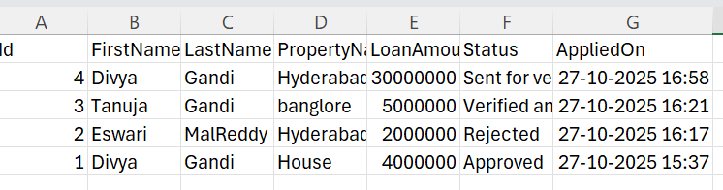

Admin Log Out
Details of Users in Admin Portal(CSV File):
Successful Log Out:

Slide 29
Make
it
real.
THANK YOU

